Slide 1
FYP5: Object Detection, Tracking and Suspicious Activity Recognition for Maritime Surveillance using Thermal Vision

Slide 2
Weekly Tasks
Looking into Real-Time Online Action Detection: ROAD
Converting the SSD model to CornerNet-Lite model in ROAD
Converting MATLAB scripts to Python

Slide 3
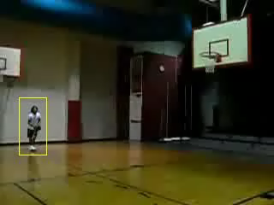
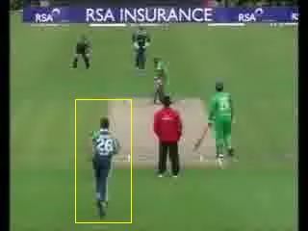
Results obtained from Real-time online Action Detection: ROAD
Basketball
Cricket Bowling

Slide 4
Integration of CornerNet-Lite with ROAD
Integration has been completed
Training on RGB UCF24 has begun
Debugging
To Do:
Train on Optical flow of UCF24
Connect to the tube construction algorithm
Build pipeline and test

Slide 5
Research Directions
Thermal-Video Optimized Activity Detection Model:
Optimize optical flow estimation for thermal images
Train a Generative Adversarial Network (GAN) to generate synthetic Thermal data to train Thermal Activity Detection Models
RGB Optimized Online Activity Detection Model:
Temporally aware convolutional block
Temporally aware head

Slide 6
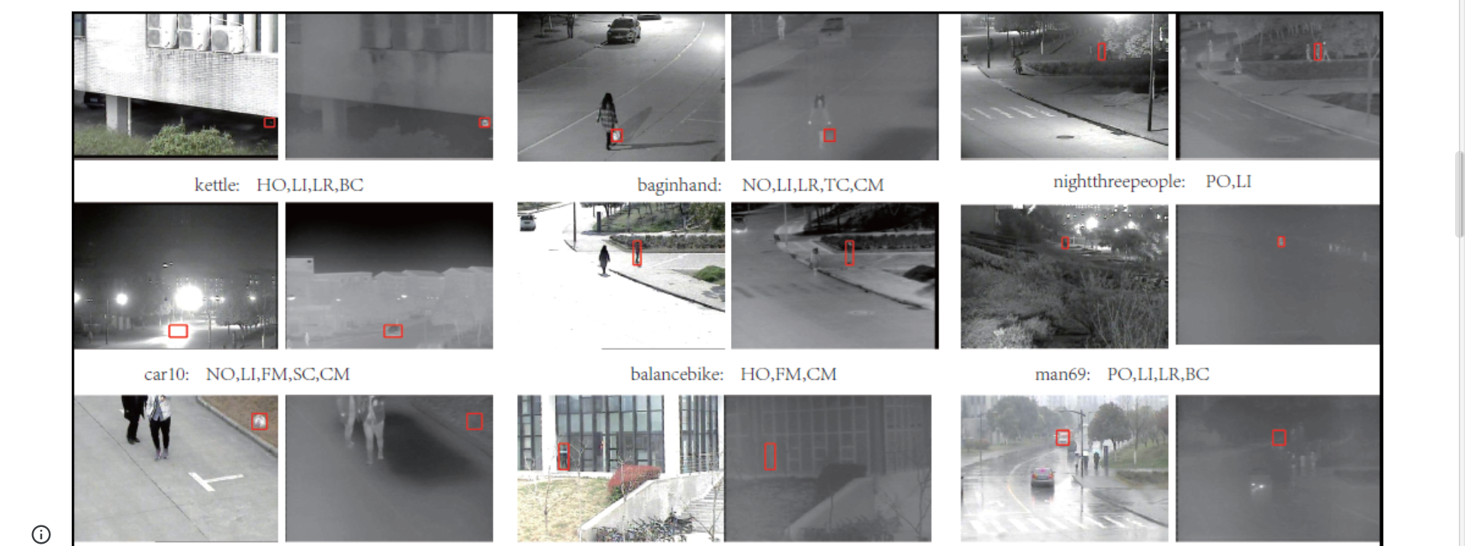
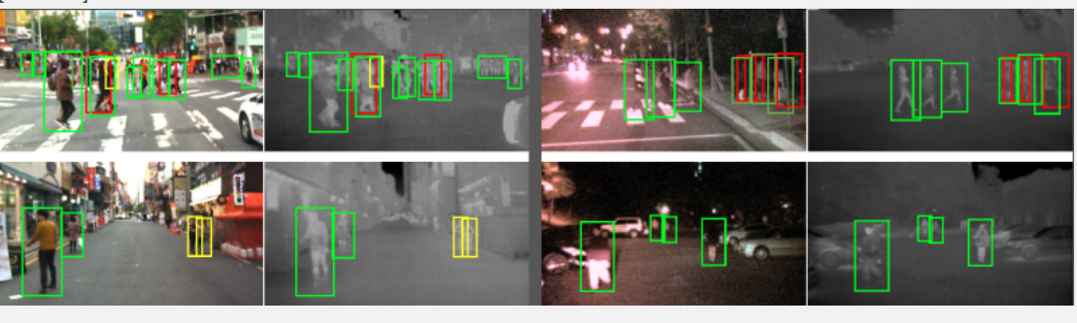
RGB-T Datasets
Paper - https://arxiv.org/pdf/1805.08982.pdf
dataset - https://sites.google.com/view/ahutracking001/
git repo- https://github.com/SoonminHwang/rgbt-ped-detection
dataset - https://soonminhwang.github.io/rgbt-ped-detection/
Paper - https://arxiv.org/pdf/2007.03262.pdf
dataset - https://pan.baidu.com/s/1O5TC-5sEya8N2EGm-xJ5mw#list/path=%2F

Slide 7

Tasks for next week
Work on the integration of CornerNet-Lite with ROAD
Conversion of MATLAB scripts to Python
Creating the pipeline for ROAD
Look into training of the GAN using RGB-T Datasets

